Slide 1

BDA
Big Data Analytics
Raj Kamal Yadav
2016076
Rajat Bansal
2016260
Programming Assignment-3, BDA Analyze the tweets related to Coronavirus. Implement Reservoir Sampling to sample real time stream data(tweets). Implement the AMS algorithm and find out the surprise number for a window of different intervals.

Slide 2
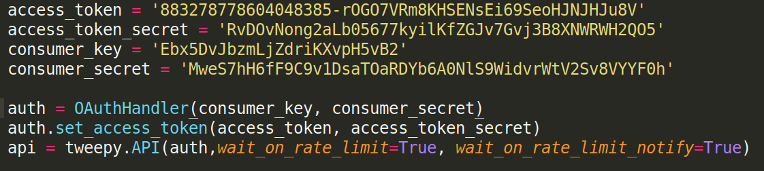
Connection To Twitter
Twitter API’s like Tweepy strongly restricts no. of requests per time window. Rate limits are divided into periods of 15/call. There is no definition of authenticated calls and rate limits, so all endpoints require authentication.
Wait_on_rate_limit: Sleeps the request for the remaining window before the rate limit resets. Failed to add this, the code will throw an error once the no. of requests is filled.

Slide 3
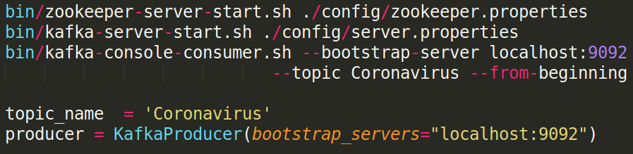
View Tweets in Real Time Console Output
Producer: Generates a stream to be passed on the Consumer to send updates real time.
Consumer: Traverses the stream and prints the output to the console.

Slide 4
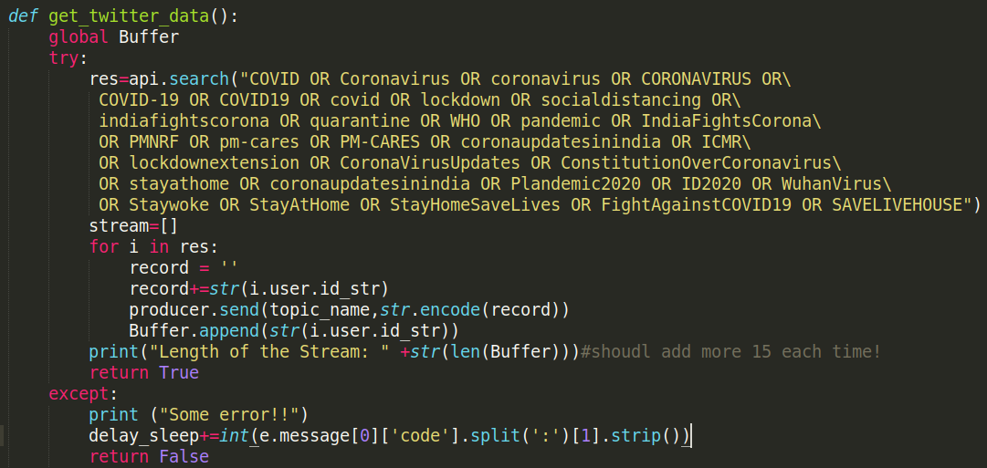
Extract Tweets Related to Selected Topic
The above function searches for tweets based on related topics. Then extract user_id from the tweet and add it to the stream.
Each time a request is made, at most only 15 tweets could be added to the stream.

Slide 5
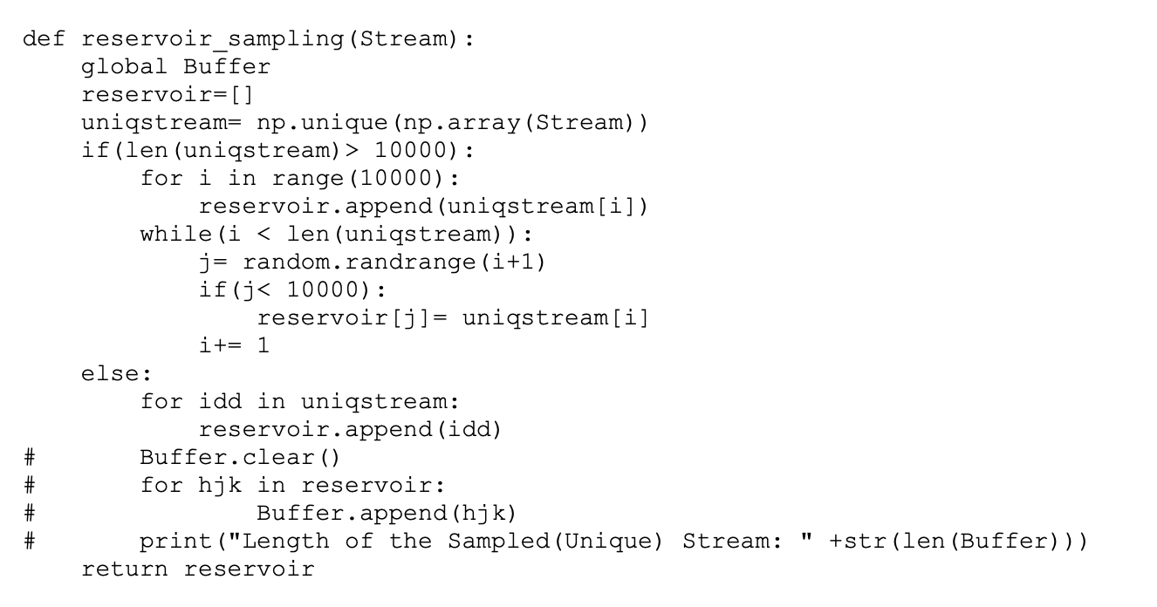
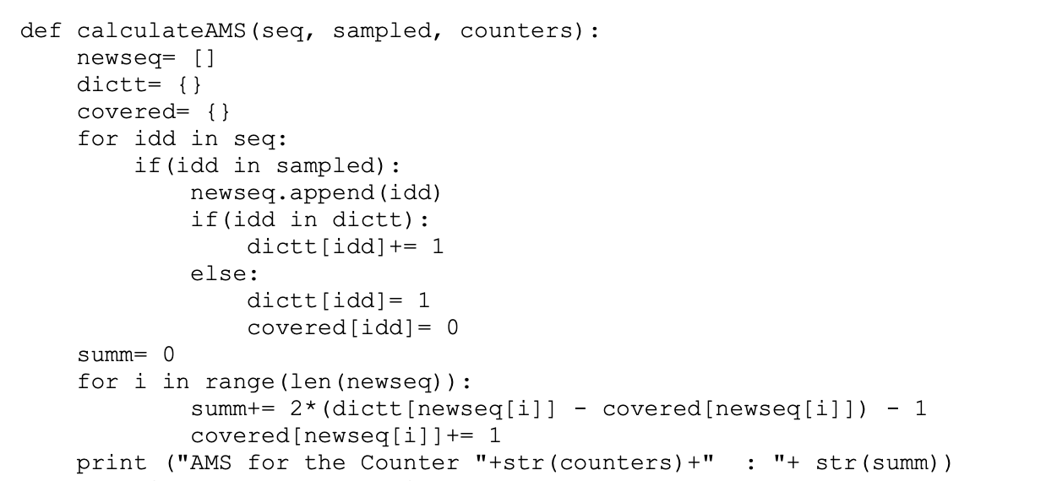
Terminology and Methodology
Buffer: Refers to the stream of user-ids of the tweets streamed from twitter.
Reservoir: Refers to the sampled user-ids(unique) from the buffer.
Reservoir Sampling: Buffer >> Unique ids from Buffer >> Sampled with k= 10,000(if less than 10,000 unique elements, all are sampled.
AMS Algorithm: Only the elements of stream that belong to sampled ids >> apply AMS >> returns Surprise Number.

Slide 6
OUTPUT OF THE RESERVOIR SAMPLING AND AMS ALGORITHM FOR THE INTERVAL OF 10 MINUTES (Iterated 15 times)

Slide 7
Iteration No. | SURPRISE NUMBER (2nd Moment) | Reservoir Size (BUFFER LENGTH) | TWEETS COUNT (STREAM LENGTH)
1 | 21276 | 519 | 3218
2 | 24433 | 536 | 3536
3 | 22491 | 513 | 3255
4 | 21847 | 535 | 3317
5 | 24489 | 497 | 3109
6 | 25697 | 519 | 3209
7 | 23818 | 515 | 3211

Slide 8
8 | 26869 | 496 | 3146
9 | 23198 | 525 | 3321
10 | 26968 | 531 | 3278
11 | 24443 | 494 | 3073
12 | 25642 | 541 | 3532
13 | 26150 | 493 | 3165
14 | 25898 | 518 | 3328
15 | 23206 | 537 | 3286

Slide 9
OUTPUT OF THE RESERVOIR SAMPLING AND AMS ALGORITHM FOR THE INTERVAL OF 20 MINUTES (Iterated 15 times)

Slide 10
Iteration No. | SURPRISE NUMBER (2nd Moment) | Reservoir Size (BUFFER LENGTH) | TWEETS COUNT (STREAM LENGTH)
1 | 47843 | 941 | 6392
2 | 43805 | 993 | 6535
3 | 40961 | 909 | 6058
4 | 47725 | 991 | 6517
5 | 46204 | 927 | 6306
6 | 44459 | 961 | 6179
7 | 44081 | 937 | 6421

Slide 11
8 | 41560 | 911 | 6208
9 | 44292 | 1025 | 6583
10 | 44937 | 893 | 6257
11 | 41376 | 917 | 6038
12 | 47309 | 868 | 6178
13 | 43045 | 971 | 6559
14 | 48247 | 899 | 6297
15 | 41463 | 965 | 6196

Slide 12
OUTPUT OF THE RESERVOIR SAMPLING AND AMS ALGORITHM FOR THE INTERVAL OF 30 MINUTES (Iterated 15 times)

Slide 13
Iteration No. | SURPRISE NUMBER (2nd Moment) | Reservoir Size (BUFFER LENGTH) | TWEETS COUNT (STREAM LENGTH)
1 | 65473 | 1385 | 9126
2 | 61735 | 1272 | 8948
3 | 68281 | 1515 | 9437
4 | 66548 | 1319 | 9458
5 | 69704 | 1285 | 9373
6 | 63123 | 1606 | 8709
7 | 67421 | 1396 | 9193

Slide 14
8 | 62703 | 1551 | 9003
9 | 61165 | 1428 | 8861
10 | 68293 | 1613 | 9451
11 | 66134 | 1199 | 9287
12 | 65386 | 1216 | 9463
13 | 68937 | 1276 | 9538
14 | 62908 | 1377 | 8983
15 | 68307 | 1589 | 9323

Slide 15
OUTPUT OF THE RESERVOIR SAMPLING AND AMS ALGORITHM FOR THE INTERVAL OF 40 MINUTES (Iterated 15 times)

Slide 16
Iteration No. | SURPRISE NUMBER (2nd Moment) | Reservoir Size (BUFFER LENGTH) | TWEETS COUNT (STREAM LENGTH)
1 | 100776 | 1827 | 13805
2 | 90619 | 1593 | 12057
3 | 88243 | 1748 | 11672
4 | 100193 | 1778 | 13408
5 | 85041 | 1639 | 11073
6 | 98249 | 1983 | 12981
7 | 83195 | 1762 | 11361

Slide 17
8 | 94505 | 1931 | 12538
9 | 91670 | 1589 | 11874
10 | 103154 | 1927 | 13459
11 | 88321 | 1707 | 11771
12 | 94806 | 1821 | 12459
13 | 96209 | 1988 | 13063
14 | 92264 | 1591 | 12765
15 | 85365 | 1972 | 11398

Slide 18
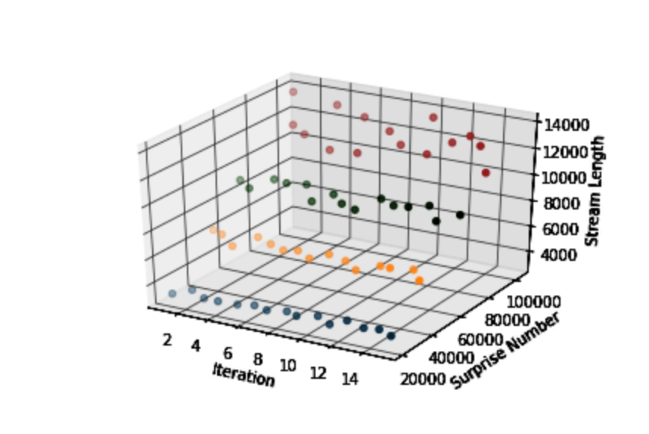
3D Graphical Summary of the Tables

Slide 19
Average Surprise No. (2nd Moment) for every interval repeated over 15 iterations

Slide 20
Interval Period | Avg.SURPRISE NUMBER (2nd Moment) | Avg. Reservoir Size (BUFFER LENGTH) | Avg. TWEETS COUNT (Stream LENGTH)
10 | 24428 | 517 | 3265
20 | 44487 | 940 | 6314
30 | 65741 | 1401 | 9210
40 | 92840 | 1790 | 12378

Slide 21
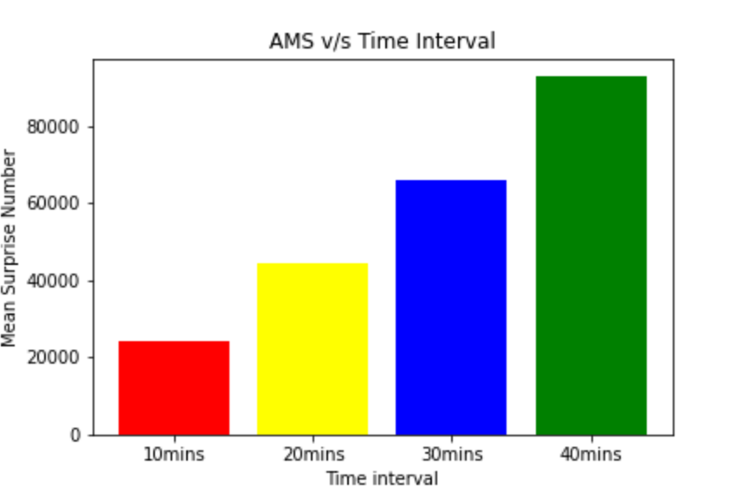
2D Graphical Summary of the Mean Table

Slide 22
Learnings from the Assignment
We learnt about how crawling/ extracting tweets from Twitter Python API Tweepy.
Learnt the pros and cons of using different twitter API’s for streaming tweets and rate limits.
Learnt about Kafka, its setup, usage(Producer+Consumer) and monitoring twitter continuous stream of tweets(data).
Hands on experience of AMS estimate, Reservoir Sampling and handling of real time data, catching exception to avoid unintentional code breakage.
Learnt the real life significance of Surprise Number to actual meaningful data.

Slide 23
It was learnt that Reservoir Sampling is applied on a stream/array only after duplicates have been removed. The AMS algorithm then computer the surprise number of a subset of the stream that contain the elements sampled by reservoir sampling.

Slide 24
Challenges faced in solving the assignment
Unavailability of Twitter Developer Account. Applied for the Account but it takes more than a week for approval. Could not reach out to peers since they had to record the reading as well and adding more users per account leads to insignificant number of Rate Limit Sleep which corrupts the reading. Started the experiment very late borrowing the credentials from a peer once he has completed recording his readings. The code execution takes around
10*15 + 20*15 + 30*15 + 40*15 = 1500 minute = 25 hrs. of uninterrupted runtime.
Can’t run the same code in 2 places due to rate limit restrictions.
Number of tweets retrieved in any given interval is a function of the internet speed as well as machine specifications on which the code was run.

Slide 25
Absence of Reservoir Sampling and AMS algorithm API’s in Apache Spark, Storm, Flume.
Really scarce documentation/blogs online to refer from.
Version mismatch. Often specific versions of Pyspark run specific versions of Kafka or if you are running Spark, that also runs specific versions of Kafka, Scala and the streaming api’s(Apache Flume/Apache Storm) making it difficult to integrate.
Tasks that are unnecessarily long/repetitive are the biggest challenge and can be reduced in the future.

Slide 26
Due to erratic tweepy behaviour (rate limits, taking more time depending on internet bandwidth, laptop specifications and internet connection stability), we keep storing the local sleep time of the api and extend the interval by the same.
Eg.
If the interval was 10 mins and we started at 9:00 and encounter Rate Limit as following:
Length of the Stream: 960 3.180041702588399
Rate limit reached. Sleeping for: 314
Length of the Stream: 975 8.542892889181774
Then instead of running it till 9:10 we increase the window by the sleep time 314/60 mins.

Slide 27
Resources Used
What is Reservoir Sampling?
https://www.youtube.com/watch?v=Ybra0uGEkpM&t=329s
2) What is AMS Algorithm? http://resources.mpi-inf.mpg.de/departments/d1/teaching/ss14/gitcs/notes3.pdf

